Slide 1
INFLAMMATORY JOINT DISEASE
These are caused by infection or immunological factors.
These conditions are characterized by inflammation of the synovial membrane with resultant changes in the synovial fluid.
Systemic signs may include fever, lethargy, anorexia, and leukocytosis.
Infectious Disease (Arthritis)
Joint infections are caused by bacteria that enter the joint either through penetrating wounds or through the bloodstream.
infections usually have been caused by external wounds (e.g., surgery, gunshot, abrasion, laceration).
The severity of joint destruction depends on the type of bacteria and the duration of infection.

Slide 2
Corynebacterium pyogenes infection causes severe pannus formation (granulation) over cartilaginous surfaces, whereas
Clostridium species can elaborate collagenase.
Streptococcus and Staphylococcus produce kinases that activate plasminogen and result in plasmin, which removes chondroprotein from cartilage matrix.
All these infections result in severe and widespread cartilage damage.
Other bacteria may not produce destructive enzymes, and widespread permanent damage may not occur.
Diagnosis
1. synovial fluid analysis and Wright’s staining of the centrifuged exudate.
2. Culture and sensitivity of this fluid are mandatory, although synovial biopsy culture is better.
3. Early radiographs may show capsular distention, and subchondral lysis may appear later.

Slide 3
Early infections (within first 24-48 hours) may respond to joint aspiration and systemic antibiotics without arthrotomy.
Arthrotomy allows
debridement of necrotic material;
removal of fibrin clots, which may serve as a nidus for infection; and
subtotal synovectomy, if joint motion is restricted by the thickened joint capsule encroaching on the articular cartilage.
Local instillation of antibiotics is contraindicated for two reasons:
systemic antibiotics achieve adequate levels in the joint
chemical synovitis may be created, enhancing the inflammation
If the joint is destroyed, arthrodesis may be indicated after the infection clears.

Slide 4
Noninfectious Diseases (Immunological Joint Disease)
those that erode cartilage (e.g., rheumatoid arthritis)
those that do not erode cartilage
(e.g., systemic lupus erythematosus).
Erosive Inflammatory Disease:
Rheumatoid Arthritisis
is defined as a severe, often progressive, polyarthritis of unknown etiology.

Slide 5
Pathogenesis of RA.
some unknown reason
Endogenous immunoglobulin G (IgG) protein becomes altered and stimulates IgG and IgM antibodies (rheumatoid factors)
combine to form immune complexes in the joint
activate the complement sequence
resulting in leukotaxis (Leukocytes phagocytize the immune complexes)
Thereby releasing lysosomal enzymes
These enzymes contain
disrupt basement membranes
collagenase; cathepsins
cleave glycoproteins
proteases.
Alter the components of the joint.

Slide 6
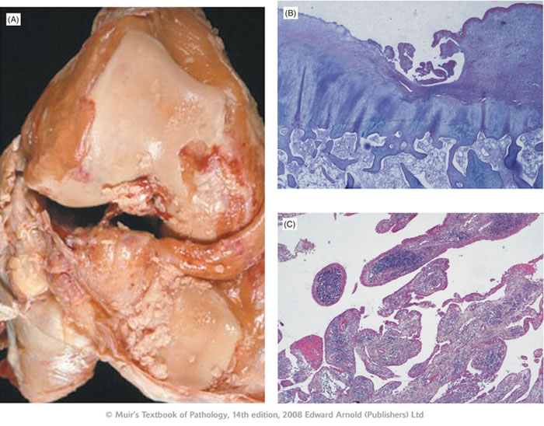
The more prolonged the synovitis, the more prominent is the joint damage
This succession of events is the basis for using antiinflammatory drugs.
Surgical synovectomy removes the immune complexes and can be effective in humans if performed early.
Erosions may be explained by the proliferative granulation tissue arising from the synovium, → which crosses the articular surface (pannus) or invades the subchondral bone at the synovial attachments.
Erosions in cartilage not covered by pannus may be caused by granulation tissue arising from the epiphyseal marrow, which erodes the subchondral bone.

Slide 7
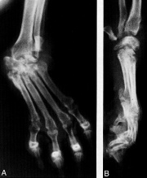
Depression, fever, and anorexia may occur with or without lameness. Joint swelling may be subtle or obvious. Often, more than one joint may be affected. With severe and chronic involvement, cartilage erosion may be detected by palpating crepitation. Joint instability of the carpus and tarsus may be apparent while the dog is ambulatory. Toes may dislocate. Spontaneous exacerbations and remissions occur.
Signs and Symptoms
Radiographic changes occurring in RA can include
soft tissue swelling,
Increased joint fluid,
decreased joint space, and
lytic areas in the subchondral bone and juxtaarticular bone.
Disuse osteoporosis appears at a later stage, and osteophytes form.
when instability occurs. The joint space decreases as cartilage becomes thinner, and it is seen especially in the carpal and tarsal joints

Slide 8
Minimal trauma (e.g., fighting, jumping from a truck) may have alerted the owner suddenly to the lameness or joint angulation.
The inflammatory response may cause necrosis within bundles of collagen, weakening and rupture of tendons and ligaments.

Slide 9
Differential diagnosis:
heart murmur
electrocardiographic changes
bacterial endocarditis
Systemic lupus erythematosus (SLE)
Traumatic arthritis and DJD
hypertrophic pulmonary osteopathy (HPO), Shifting leg lameness is seen.
Panosteitis causes a shifting leg lameness in young dogs, with some systemic signs (fever, inappetence).
little erosion of the cartilage
It does not tend to cause erosions of cartilage
it can have a high antinuclear antibody (ANA) titer.
History of sudden onset
involvement of only one joint
Careful limb palpation for swelling
radiography can usually elucidate HPO.
age
lack of joint swelling.
presence of bone pain

Slide 10
Treatment.
Antiinflammatory agents are used to block the production or action of the local mediators of the inflammatory response e.g.:
Aspirin impede the disappearance of cartilage
corticosteroids hasten the disappearance of cartilage
Other aspects of treatment consist of weight reduction, rest during flare-ups, mild exercise (swimming is excellent), synovectomy, and arthrodesis.
Synovectomy and arthrodesis are practical only if one or two joints are involved.

Slide 11
Lyme Arthritis
It caused by the spirochete Borrelia burgdorferi.
It can cause recurrent joint lameness, fever, inappetence, and lethargy.
Conditions and signs less frequently associated with Lyme arthritis include: lymphadenopathy, central nervous system (CNS) disorders, and renal and cardiac disease.
The diagnosis is presumptive and should be based on a history of tick exposure and clinical signs, which include the presence of inflammatory joint fluid.
Treatment is usually successful with the administration of antibiotics (tetracyclines, penicillins) for 3 to 4 weeks.
The use of preventive vaccines is controversial at this time and is not recommended except where Lyme arthritis is endemic.

Slide 12
Nonerosive Inflammatory Disease
involve three categories of disease:
Systemic Lupus Erythematosus (SLE)
Those associated with chronic infectious processes.
Idiopathic conditions.
Systemic Lupus Erythematosus
The distinguishing feature of SLE is its serological abnormalities (LE cell or ANA(Antinuclear antibodies) positive).
In humans, glomerulonephritis caused by aggregation of immune complexes in the kidney may cause death.
Aspirin may control the joint aspects of SLE, but not the kidney changes. Therefore, prednisolone is recommended and may be combined with cytotoxic drugs such as cyclophosphamide or azathioprine.

